Slide 1
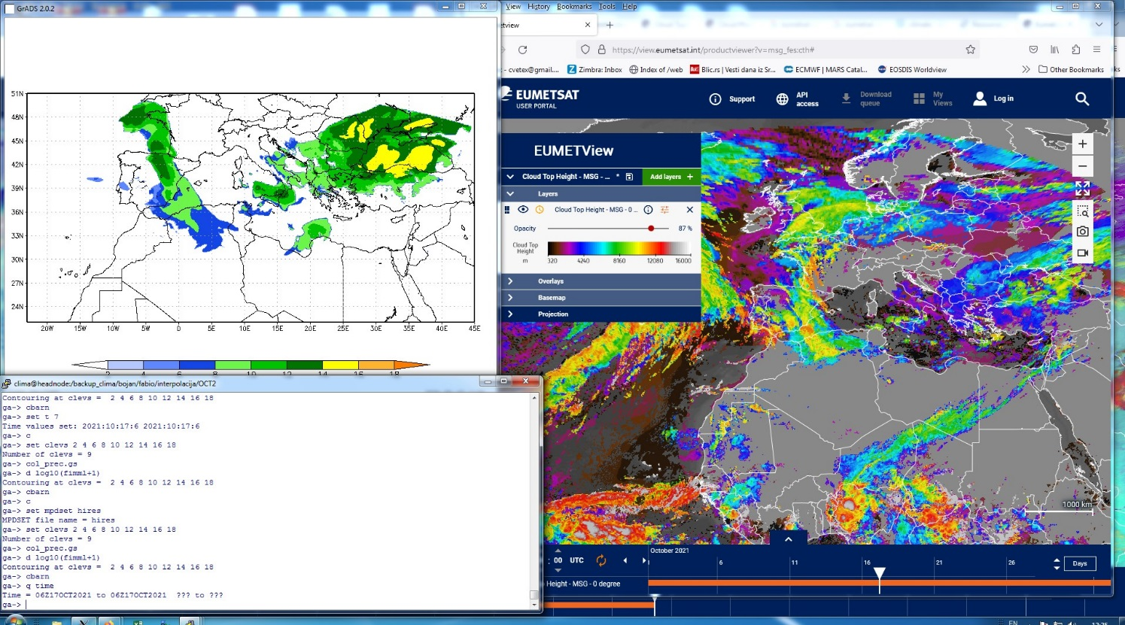
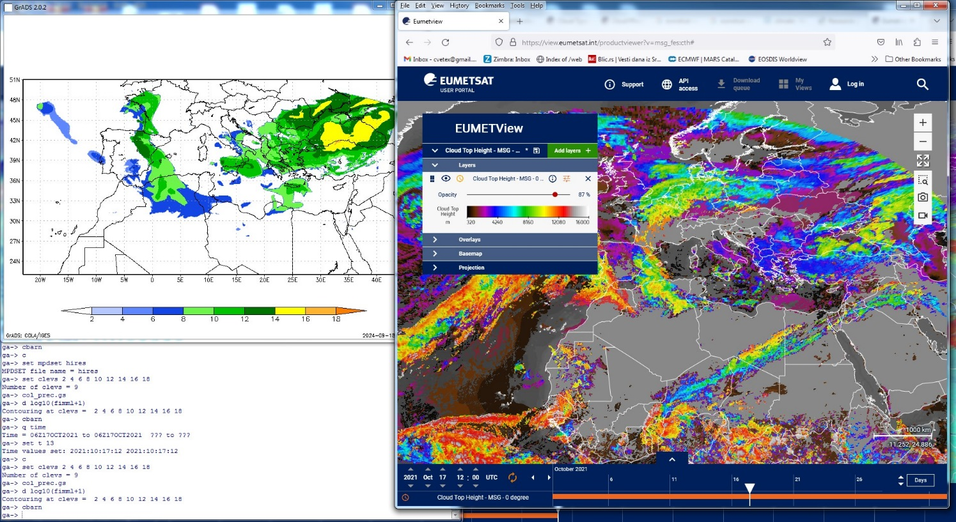
Model bio Ice VS Satellite clouds 17.Oct.2021
Ice due to Saharan Dust

Slide 2
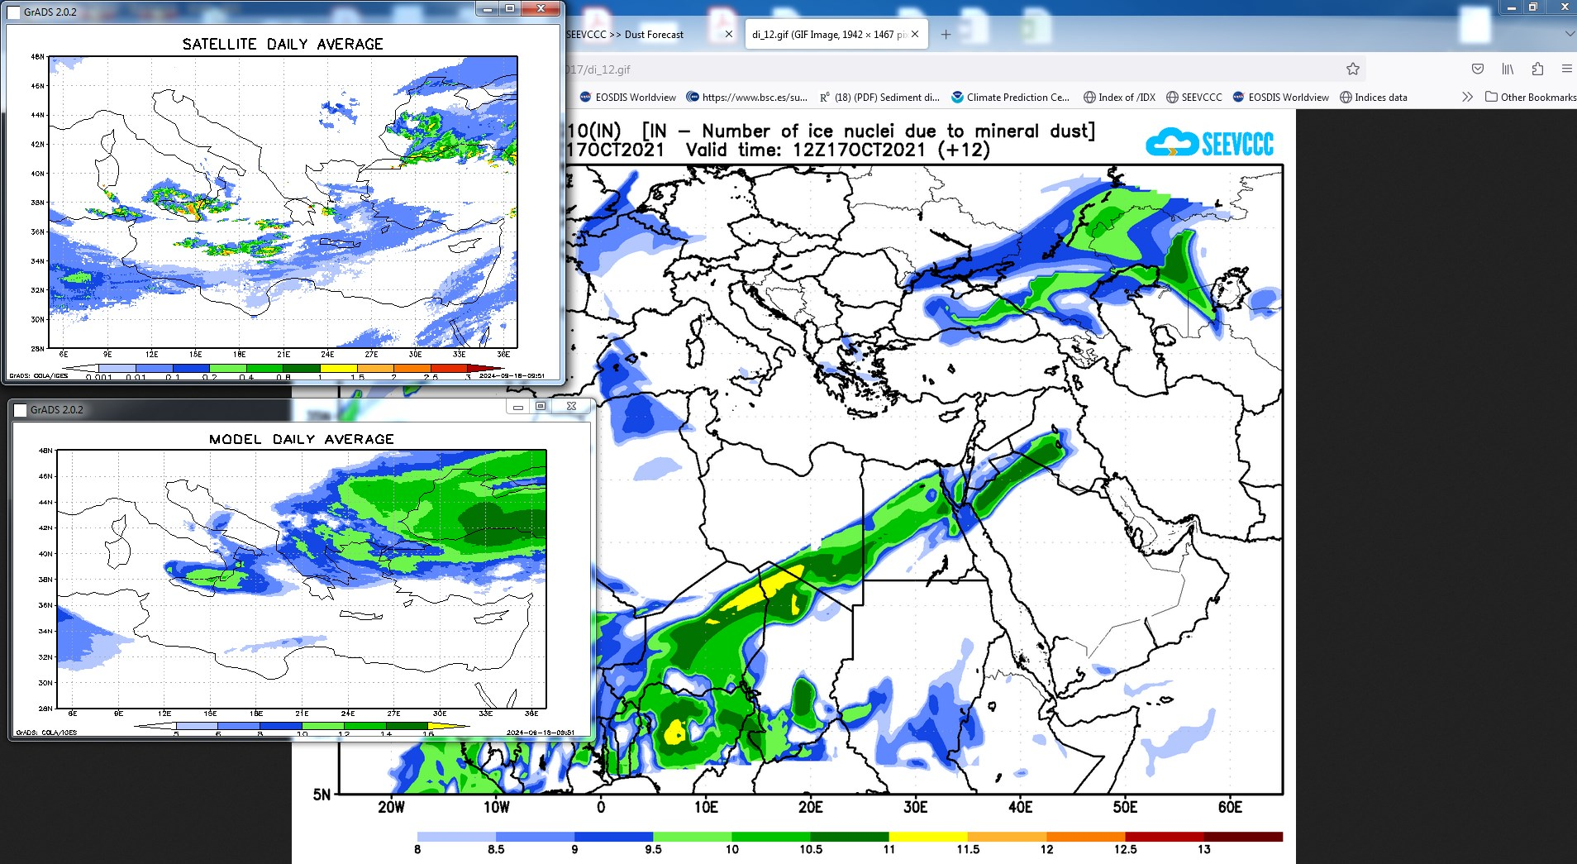
Your satellite data
SAHARAN DUST -ICE

Slide 3
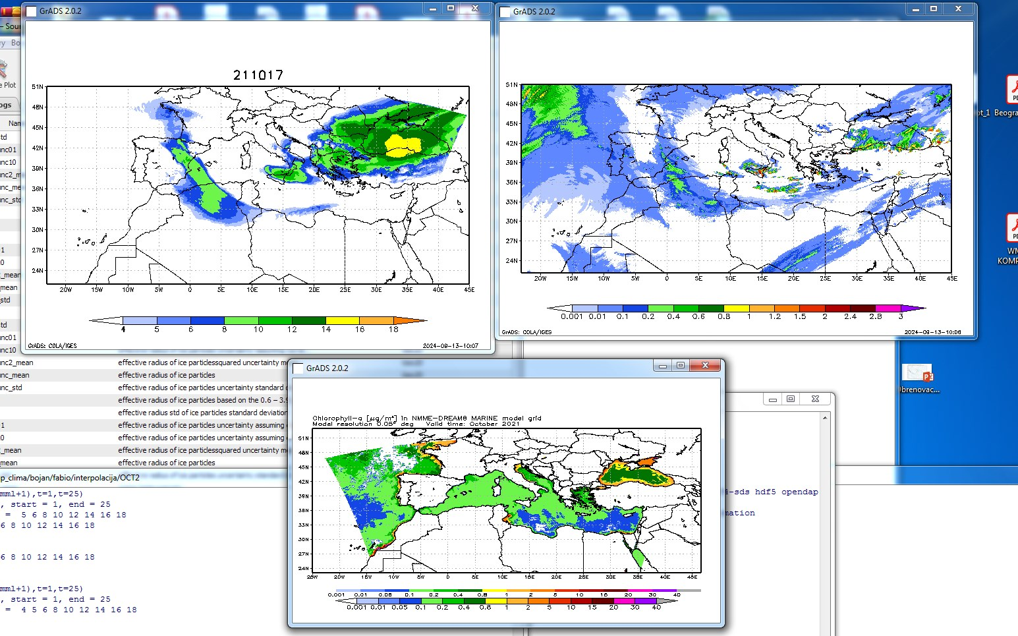
MODEL
Your Satellite data
CHL A – source map

Slide 4
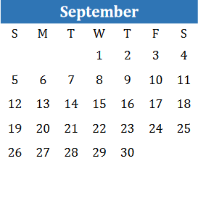
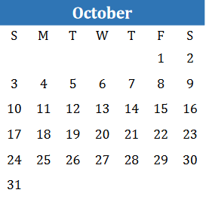
Missing IWP Seviri data
Model runs:
21.Sep – 06.Oct
15.Oct – 25.Oct
IWP Seviri data:
1) 25.Sep – 08.Oct
2) 09.Oct – 22.Oct
3) 23.Oct – 31.Oct

